Slide 1
Software Reuse

Slide 2
Objectives
To explain the benefits of software reuse and some reuse problems
To discuss several different ways to implement software reuse
To explain how reusable concepts can be represented as patterns or embedded in program generators
To discuss COTS reuse
To describe the development of software product lines

Slide 3
Topics covered
The reuse landscape
Design patterns
Generator based reuse
Application frameworks
Application system reuse

Slide 4
Software reuse
In most engineering disciplines, systems are designed by composing existing components that have been used in other systems.
Software engineering has been more focused on original development but it is now recognised that to achieve better software, more quickly and at lower cost, we need to adopt a design process that is based on systematic software reuse.

Slide 5
Reuse-based software engineering
Application system reuse
  The whole of an application system may be reused either by incorporating it without change into other systems (COTS reuse) or by developing application families.
Component reuse
  Components of an application from sub-systems to single objects may be reused. Covered in Chapter 19.
Object and function reuse
  Software components that implement a single well-defined object or function may be reused.

Slide 6
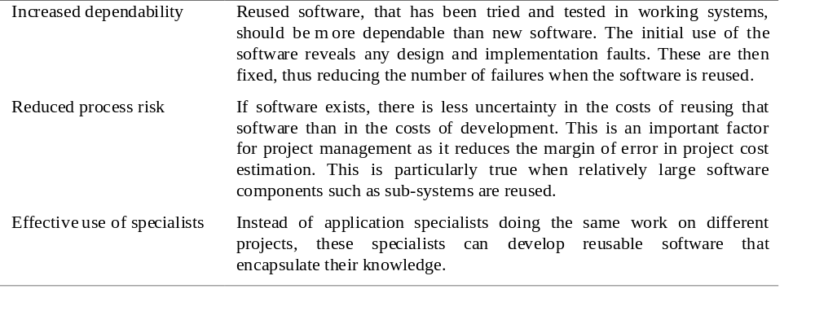
Reuse benefits 1

Slide 7
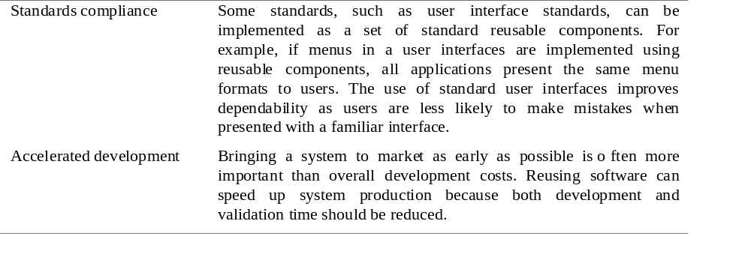
Reuse benefits 2

Slide 8
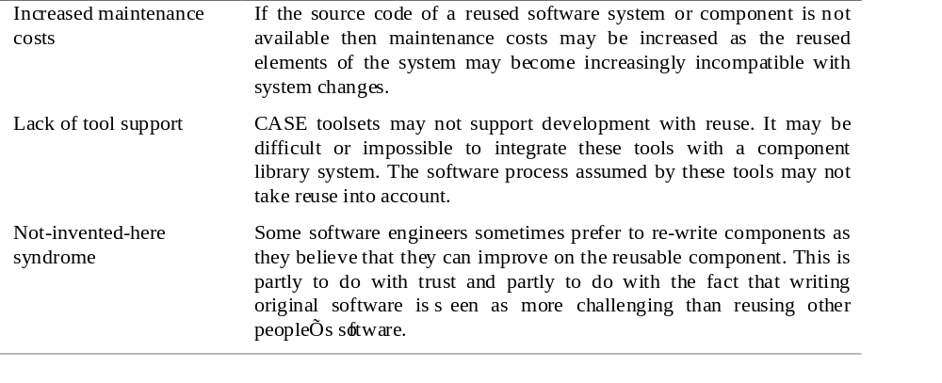
Reuse problems 1

Slide 9
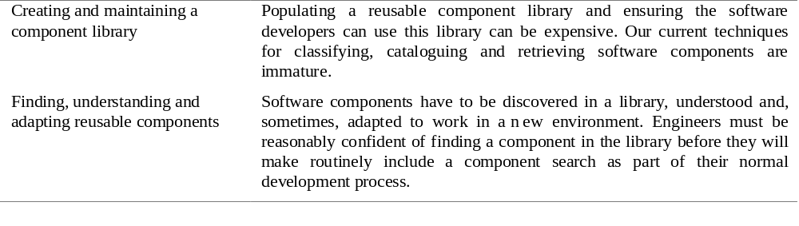
Reuse problems 2

Slide 10
The reuse landscape
Although reuse is often simply thought of as the reuse of system components, there are many different approaches to reuse that may be used.
Reuse is possible at a range of levels from simple functions to complete application systems.
The reuse landscape covers the range of possible reuse techniques.

Slide 11
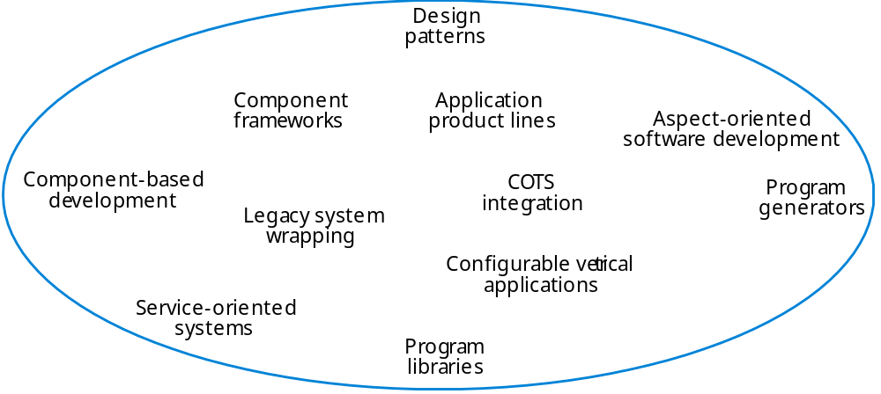
The reuse landscape

Slide 12
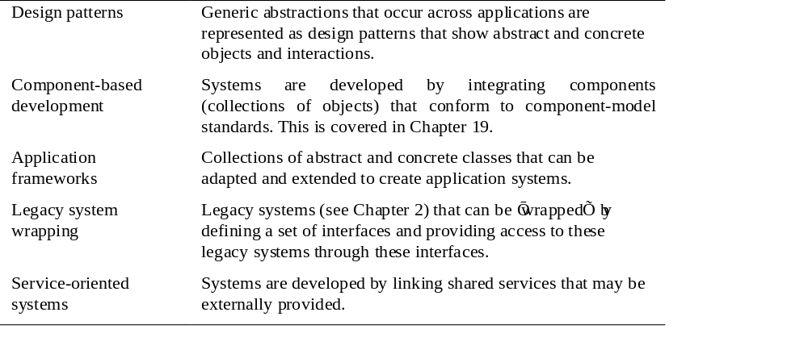
Reuse approaches 1

Slide 13
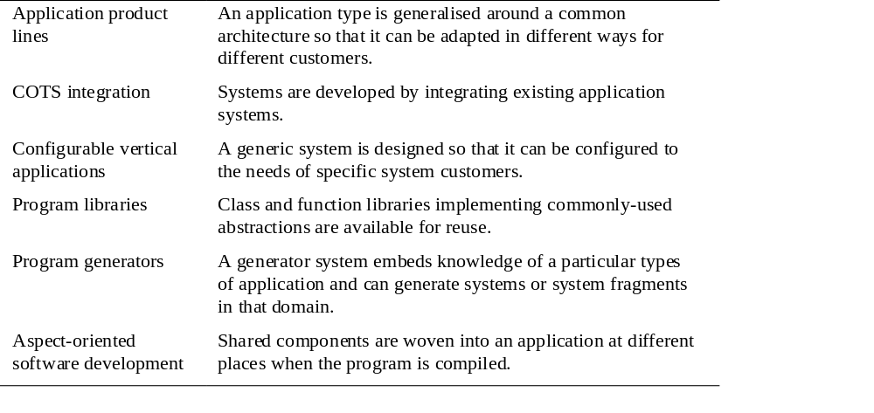
Reuse approaches 2

Slide 14
Reuse planning factors
The development schedule for the software.
The expected software lifetime.
The background, skills and experience of the development team.
The criticality of the software and its non-functional requirements.
The application domain.
The execution platform for the software.

Slide 15
Concept reuse
When you reuse program or design components, you have to follow the design decisions made by the original developer of the component.
This may limit the opportunities for reuse.
However, a more abstract form of reuse is concept reuse when a particular approach is described in an implementation independent way and an implementation is then developed.
The two main approaches to concept reuse are:
  Design patterns;
  Generative programming.

Slide 16
Design patterns
A design pattern is a way of reusing abstract knowledge about a problem and its solution.
A pattern is a description of the problem and the essence of its solution.
It should be sufficiently abstract to be reused in different settings.
Patterns often rely on object characteristics such as inheritance and polymorphism.

Slide 17
Pattern elements
Name
  A meaningful pattern identifier.
Problem description.
Solution description.
  Not a concrete design but a template for a design solution that can be instantiated in different ways.
Consequences
  The results and trade-offs of applying the pattern.

Slide 18
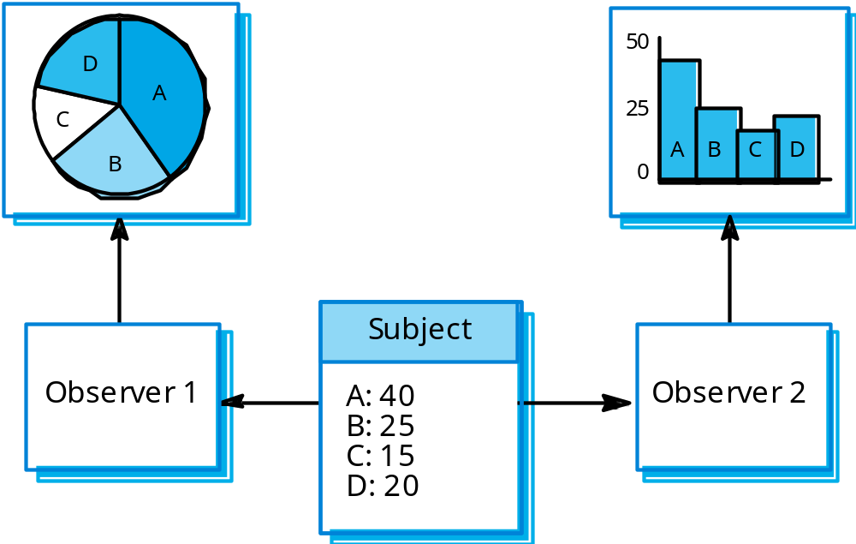
Multiple displays

Slide 19
The Observer pattern
Name
  Observer.
Description
  Separates the display of object state from the object itself.
Problem description
  Used when multiple displays of state are needed.
Solution description
  See slide with UML description.
Consequences
  Optimisations to enhance display performance are impractical.

Slide 20
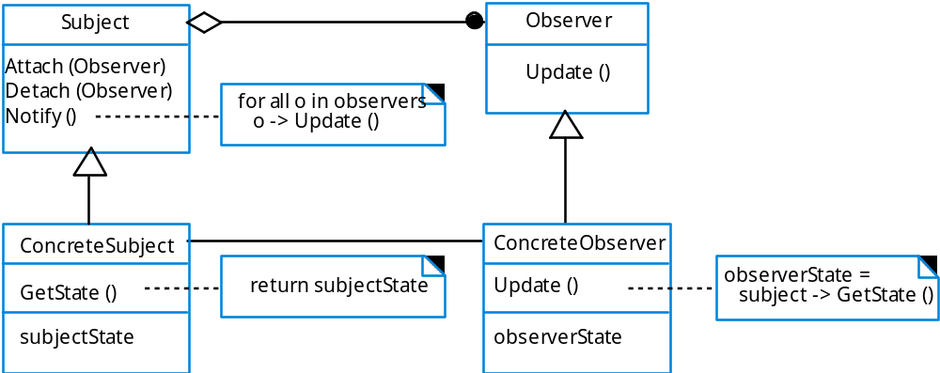
The Observer pattern

Slide 21
Generator-based reuse
Program generators involve the reuse of
standard patterns and algorithms.
These are embedded in the generator and
parameterised by user commands. A program is then automatically generated.
Generator-based reuse is possible when domain abstractions and their mapping to executable code can be identified.
A domain specific language is used to compose and control these abstractions.

Slide 22
Types of program generator
Types of program generator
  Application generators for business data processing;
  Parser and lexical analyser generators for language processing;
  Code generators in CASE tools.
Generator-based reuse is very cost-effective but its applicability is limited to a relatively small number of application domains.
It is easier for end-users to develop programs using generators compared to other component-based approaches to reuse.

Slide 23
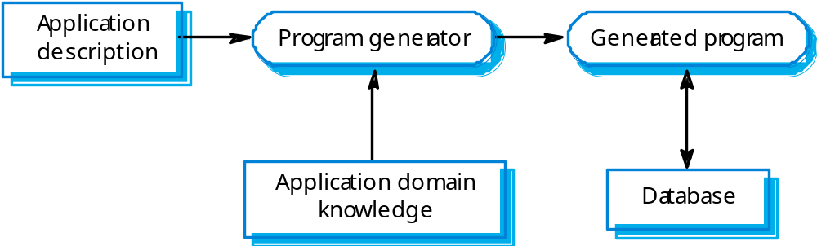
Reuse through program generation

Slide 24
Aspect-oriented development
Aspect-oriented development addresses a major software engineering problem - the separation of concerns.
Concerns are often not simply associated with application functionality but are cross-cutting - e.g. all components may monitor their own operation, all components may have to maintain security, etc.
Cross-cutting concerns are implemented as aspects and are dynamically woven into a program. The concern code is reuse and the new system is generated by the aspect weaver.

Slide 25
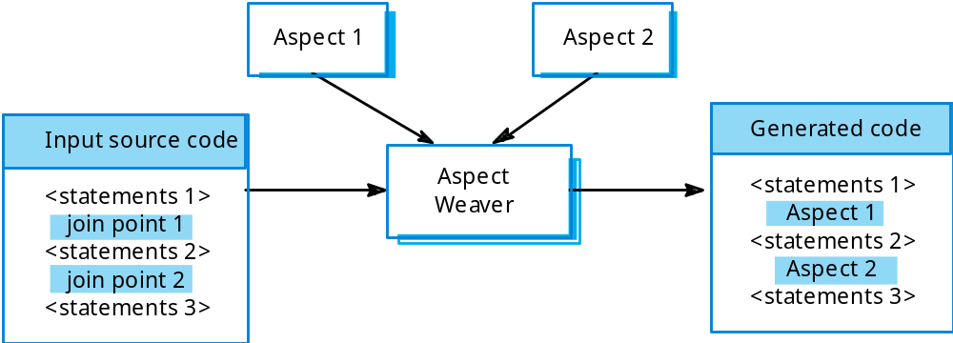
Aspect-oriented development

Slide 26
Application frameworks
Frameworks are a sub-system design made up of a collection of abstract and concrete classes and the interfaces between them.
The sub-system is implemented by adding components to fill in parts of the design and by instantiating the abstract classes in the framework.
Frameworks are moderately large entities that can be reused.

Slide 27
Framework classes
System infrastructure frameworks
  Support the development of system infrastructures such as communications, user interfaces and compilers.
Middleware integration frameworks
  Standards and classes that support component communication and information exchange.
Enterprise application frameworks
  Support the development of specific types of application such as telecommunications or financial systems.

Slide 28
Extending frameworks
Frameworks are generic and are extended to create a more specific application or sub-system.
Extending the framework involves
  Adding concrete classes that inherit operations from abstract classes in the framework;
  Adding methods that are called in response to events that are recognised by the framework.
Problem with frameworks is their complexity which means that it takes a long time to use them effectively.

Slide 29
Model-view controller
System infrastructure framework for GUI design.
Allows for multiple presentations of an object and separate interactions with these presentations.
MVC framework involves the instantiation of a number of patterns (as discussed earlier under concept reuse).

Slide 30
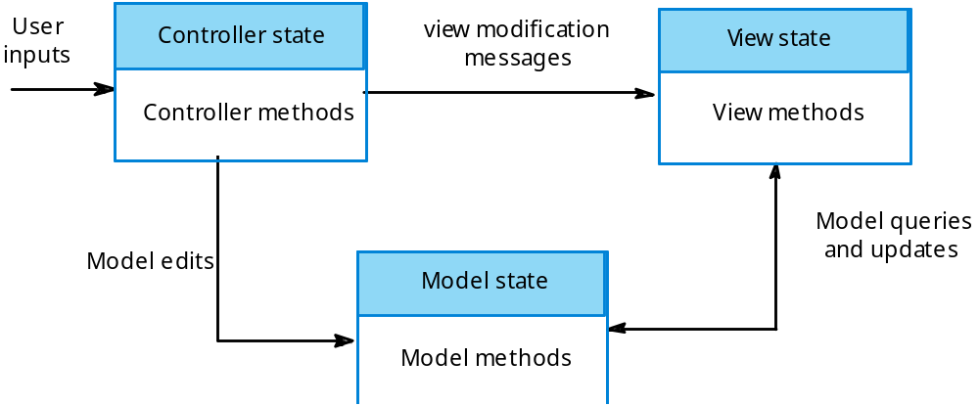
Model-view-controller

Slide 31
Application system reuse
Involves the reuse of entire application systems either by configuring a system for an environment or by integrating two or more systems to create a new application.
Two approaches covered here:
  COTS product integration;
  Product line development.

Slide 32
COTS product reuse
COTS - Commercial Off-The-Shelf systems.
COTS systems are usually complete application systems that offer an API (Application Programming Interface).
Building large systems by integrating COTS systems is now a viable development strategy for some types of system such as E-commerce systems.
The key benefit is faster application development and, usually, lower development costs.

Slide 33
COTS design choices
Which COTS products offer the most appropriate functionality?
  There may be several similar products that may be used.
How will data be exchanged?
  Individual products use their own data structures and formats.
What features of the product will actually be used?
  Most products have more functionality than is needed. You should try to deny access to unused functionality.

Slide 34
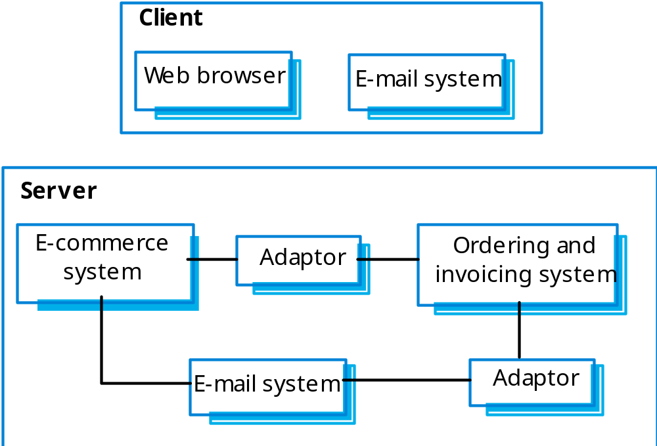
E-procurement system

Slide 35
COTS products reused
On the client, standard e-mail and web browsing programs are used.
On the server, an e-commerce platform has to be integrated with an existing ordering system.
  This involves writing an adaptor so that they can exchange data.
  An e-mail system is also integrated to generate e-mail for clients. This also requires an adaptor to receive data from the ordering and invoicing system.

Slide 36
COTS system integration problems
Lack of control over functionality and performance
  COTS systems may be less effective than they appear
Problems with COTS system inter-operability
  Different COTS systems may make different assumptions that means integration is difficult
No control over system evolution
  COTS vendors not system users control evolution
Support from COTS vendors
  COTS vendors may not offer support over the lifetime of the product

Slide 37
Software product lines
Software product lines or application families are applications with generic functionality that can be adapted and configured for use in a specific context.
Adaptation may involve:
  Component and system configuration;
  Adding new components to the system;
  Selecting from a library of existing components;
  Modifying components to meet new requirements.

Slide 38
COTS product specialisation
Platform specialisation
  Different versions of the application are developed for different platforms.
Environment specialisation
  Different versions of the application are created to handle different operating environments e.g. different types of communication equipment.
Functional specialisation
  Different versions of the application are created for customers with different requirements.
Process specialisation
  Different versions of the application are created to support different business processes.

Slide 39
COTS configuration
Deployment time configuration
  A generic system is configured by embedding knowledge of the customer’s requirements and business processes. The software itself is not changed.
Design time configuration
  A common generic code is adapted and changed according to the requirements of particular customers.

Slide 40
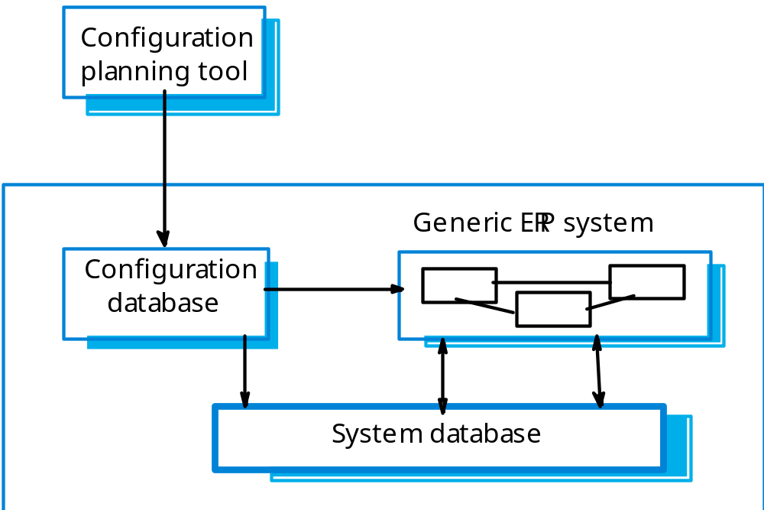
ERP system organisation

Slide 41
ERP systems
An Enterprise Resource Planning (ERP) system is a generic system that supports common business processes such as ordering and invoicing, manufacturing, etc.
These are very widely used in large companies - they represent probably the most common form of software reuse.
The generic core is adapted by including modules and by incorporating knowledge of business processes and rules.

Slide 42
Design time configuration
Software product lines that are configured at design time are instantiations of generic application architectures as discussed in Chapter 13.
Generic products usually emerge after experience with specific products.

Slide 43
Product line architectures
Architectures must be structured in such a way to separate different sub-systems and to allow them to be modified.
The architecture should also separate entities and their descriptions and the higher levels in the system access entities through descriptions rather than directly.

Slide 44
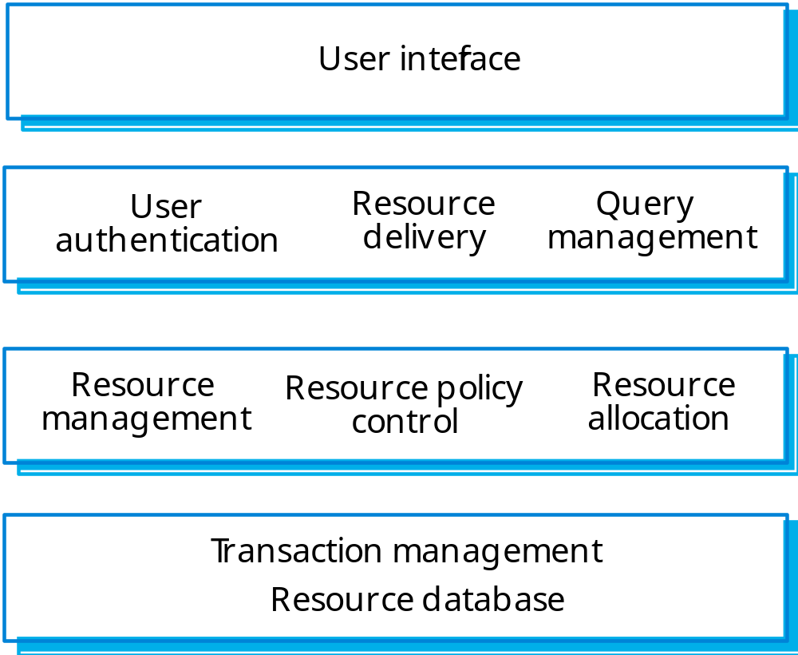
A resource management system

Slide 45
Vehicle despatching
A specialised resource management system where the aim is to allocate resources (vehicles) to handle incidents.
Adaptations include:
  At the UI level, there are components for operator display and communications;
  At the I/O management level, there are components that handle authentication, reporting and route planning;
  At the resource management level, there are components for vehicle location and despatch, managing vehicle status and incident logging;
  The database includes equipment, vehicle and map databases.

Slide 46
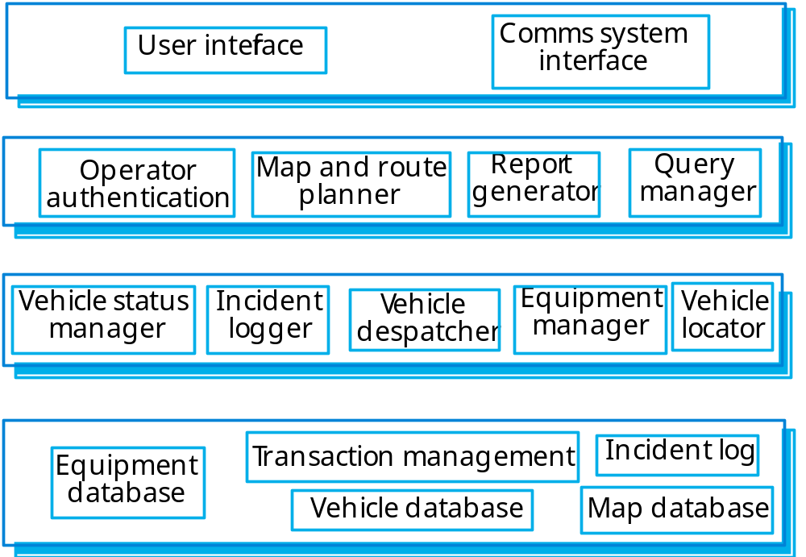
A despatching system

Slide 47
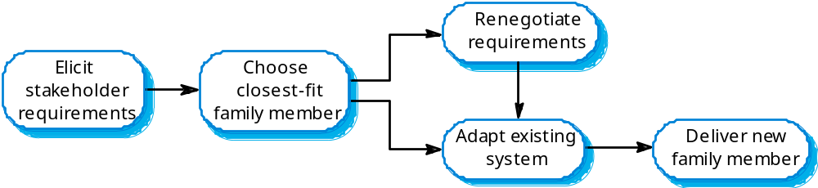
Product instance development

Slide 48
Product instance development
Elicit stakeholder requirements
  Use existing family member as a prototype
Choose closest-fit family member
  Find the family member that best meets the requirements
Re-negotiate requirements
  Adapt requirements as necessary to capabilities of the software
Adapt existing system
  Develop new modules and make changes for family member
Deliver new family member
  Document key features for further member development

Slide 49
Key points
Advantages of reuse are lower costs, faster software development and lower risks.
Design patterns are high-level abstractions that document successful design solutions.
Program generators are also concerned with software reuse - the reusable concepts are embedded in a generator system.
Application frameworks are collections of concrete and abstract objects that are designed for reuse through specialisation.

Slide 50
Key points
COTS product reuse is concerned with the reuse of large, off-the-shelf systems.
Problems with COTS reuse include lack of control over functionality, performance, and evolution and problems with inter-operation.
ERP systems are created by configuring a generic system with information about a customer’s business.
Software product lines are related applications developed around a common core of shared functionality.

